Slide 1


SPRI, End Preparation and Barcoding
ARTIC Network Train the Trainer - August 2022
ARTIC TRAIN 03AUG22
Rhys Izuagbe

Slide 2

Objectives
Define and detail the purpose of SPRI, EP and Barcoding
Outline the protocol for each
Introduce the next steps in the ARTIC nCOV pipeline

Slide 3
SPRI
Magnetic beads
Magnetic rack or plate
70% Ethanol
MQ grade water
Pooled amplicons of each sample

Slide 4
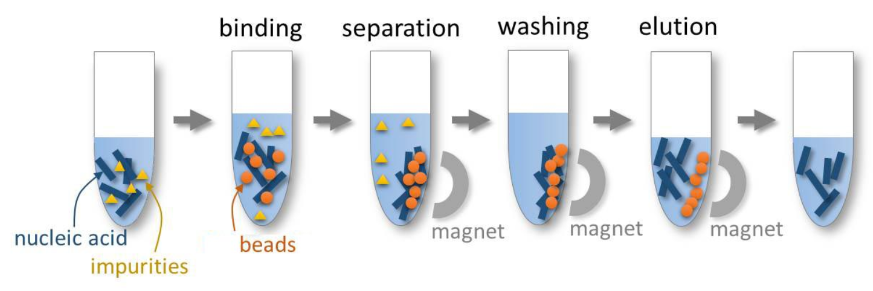
Principles of SPRI
Solid-Phase Reversible Immobilisation
Reversibly binds DNA (or RNA) to magnetic beads which can be precipitated
Unbound materials can then be easily aspirated
Excellent tool for improving qPCR and sequencing quality
Beads have a polystyrene core coated in magnetite and carboxyl layers

Slide 5
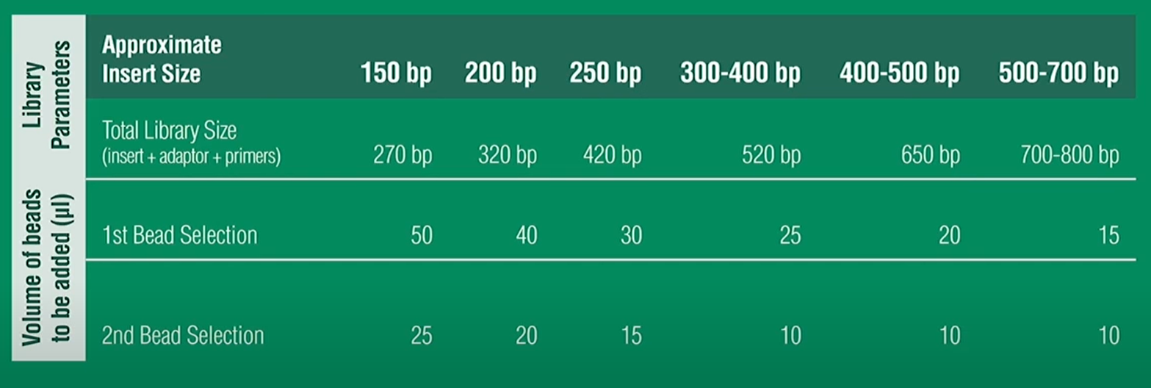
Principles of SPRI
Size selection
Specific ratios of bead solution containing PEG and NaCL to sample
Important to adhere to the protocol targeting >400bp fragments
More complex assays can be made to remove larger DNA but is unnecessary for our purposes

Slide 6
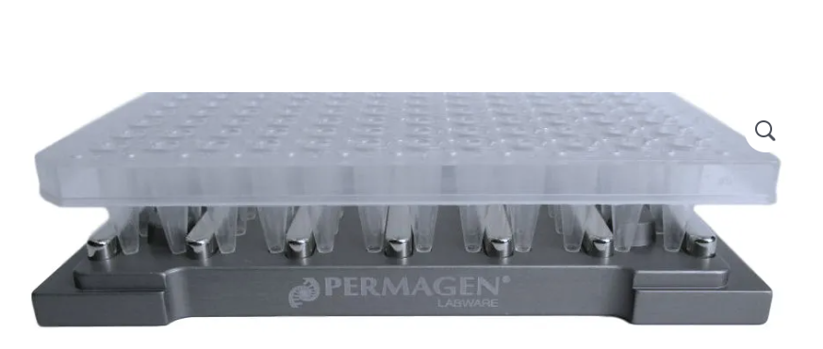
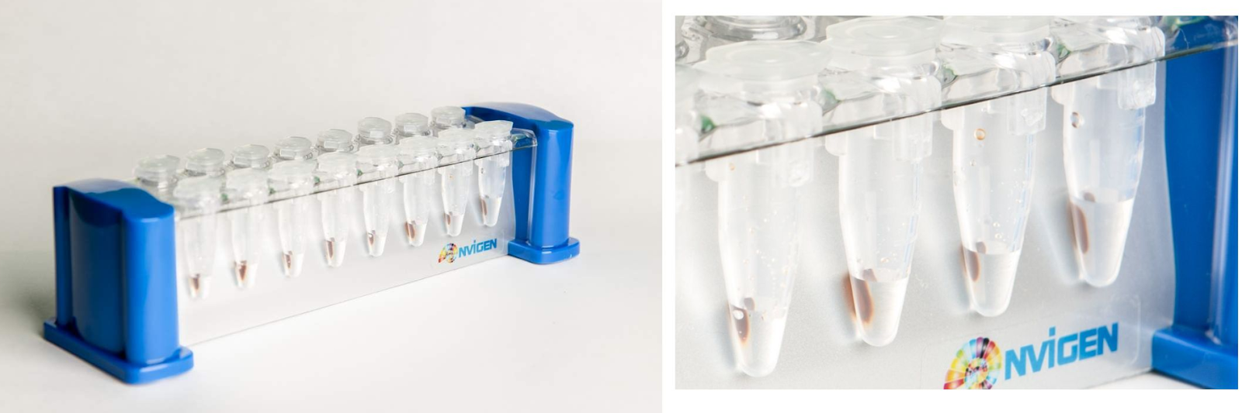
Principles of SPRI
Depending of your number of samples/ personal preference SPRI can be done in a tube or plate format
Magnetic apparatus are available with either side or ring magnets
Side magnets bind beads to one side allowing aspiration on the other
Ring magnets bind beads all around the well exterior, aspirate from the centre

Slide 7
SPRI steps
Mix samples with SPRI beads and incubate
Place plate on magnet and wait for separation
Aspirate supernatant while on the magnet
Wash twice with 70% ethanol
Add ethanol while beads are fixed on the magnet
“Rock” the sample plate side to side on the magnet 10x
Aspirate supernatant while on the magnet
Mix samples in MQ and incubate
Place on magnet and elute to new plate
Notes:
MIXING
Use a reservoir for the SPRI beads. Mix samples thoroughly using a new tip for each sample – place tip into tip park after mixing each sample.
Ensure the plate is properly seated on the magnet
ASPIRATING
When aspirating (with a side magnet) guide the pipette tip up and down the opposite wall to avoid disturbing the beads
Aspirate as much supernatant as possible
WASTE
Dispense slowly, avoid bubbles and aerosols. Capture waste in an empty tip box with paper towel in the bottom.
When disposing tips, eject only when tips ate contained in the waste bag.
WASH
Ethanol will quickly evaporate drying beads. Do not let beads air dry for more than 1min
ELUTE
Elute 35ul of the total 40ul to avoid bead carryover

Slide 8
Practical tips
The ARTIC nCOV SPRI would use 9 pipette tips per sample
With careful handling and a tip park this is reduced to 3
A tip park stores tips so they can be reused with the same sample
Each tip sits in a fully enclosed box preventing cross contamination

Slide 9
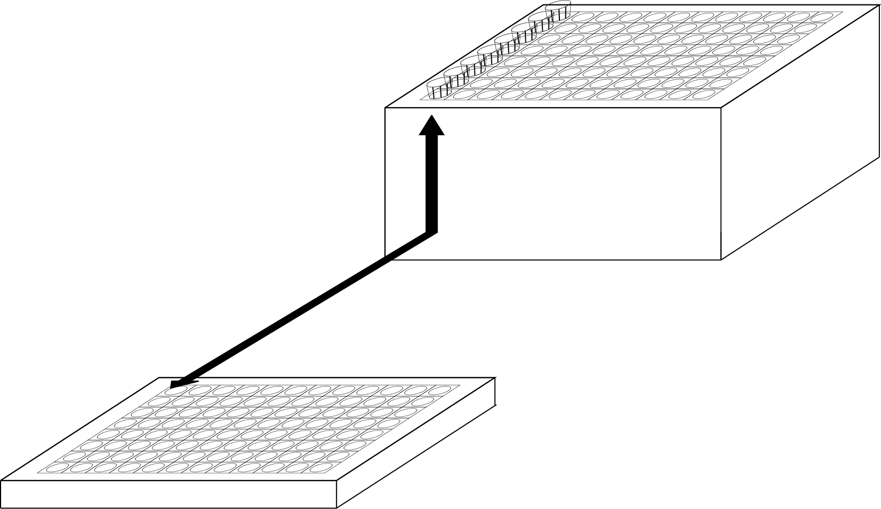
Using a tip park
Always keep the tip park in the same orientation as your samples
After aspirating, carefully dispense waste into a container without blowout
Carefully lower tips into the park and eject
If at any time you think cross contamination has occurred, discard and replace affected tips

Slide 10
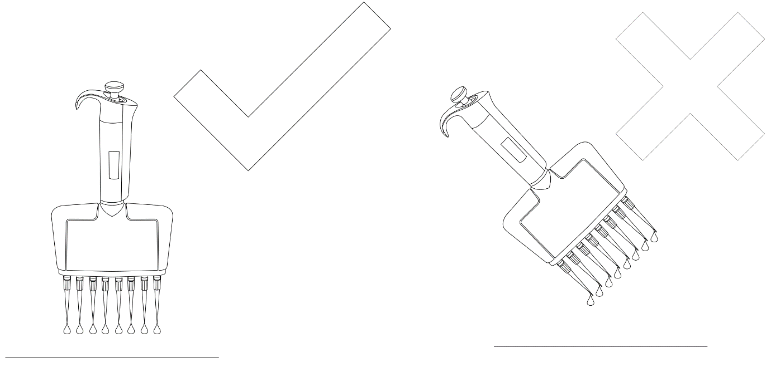
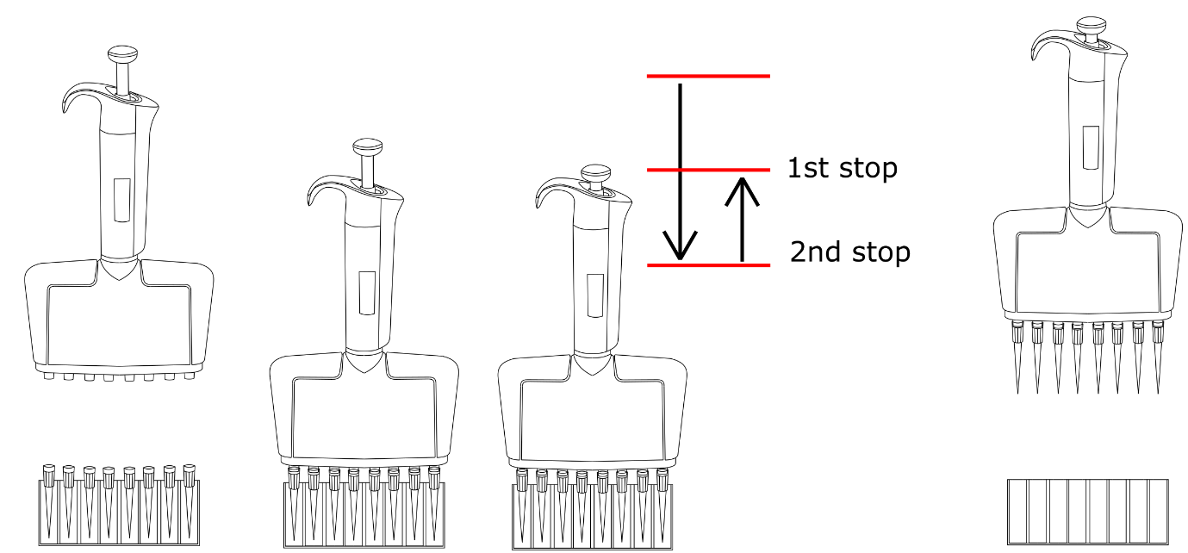
Using a tip park
Always keep the pipette vertical
Never blowout outside of the tip park
Dispense waste slowly avoiding aerosols
When taking tips (1), firmly seat your pipette (2), plunge to the second stop before resting at the first stop (3)
Keep the plunger depressed to the first stop and carefully raise tips (4)
4
1
2
3

Slide 11
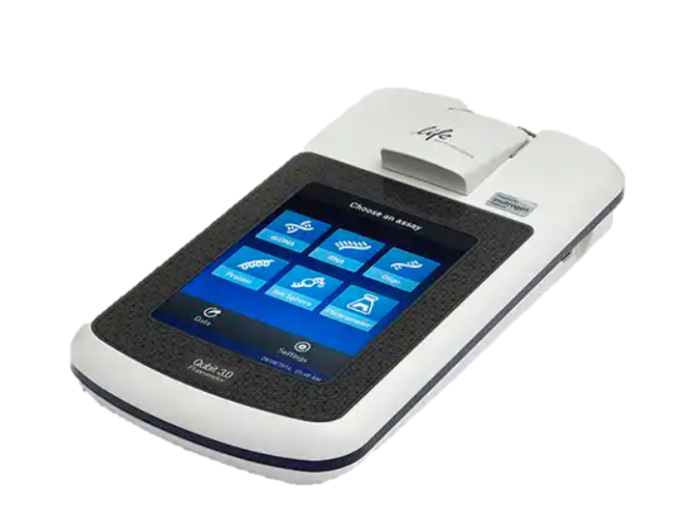
QC and quantification
Following SPRI, fluorometric analysis can be done by QUBIT
Generally, samples >3ng/ul are acceptable for sequencing
Negative controls should always be checked and remain <0.0Xng/ul
Pay attention to the concentration “pattern” to improve your SPRI

Slide 12
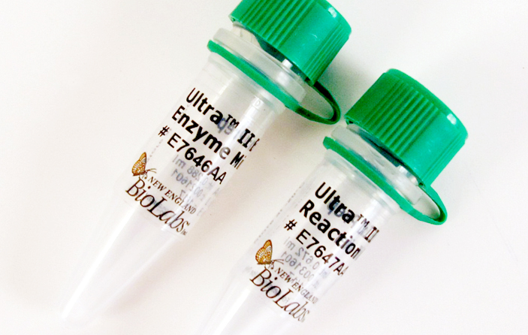
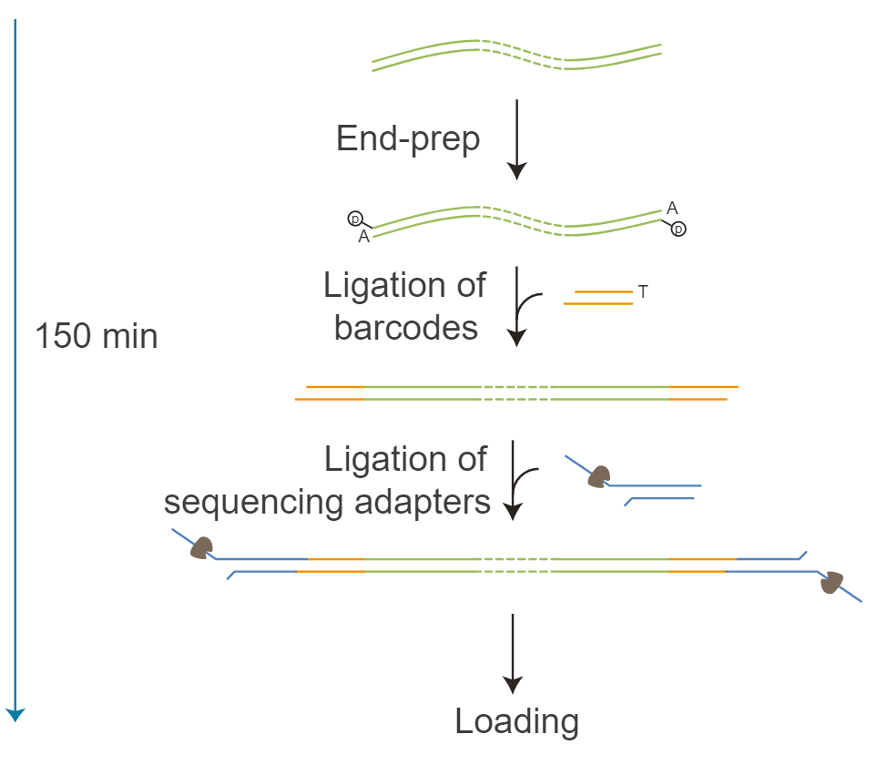
End Preparation (EP)
Prepares amplicons with dA-tailing needed for later barcode ligation
You will need:
NEBNext Ultra II End Prep Enzyme Mix
NEBNext Ultra II End Prep Reaction Buffer
Pooled SPRI-cleaned amplicons

Slide 13
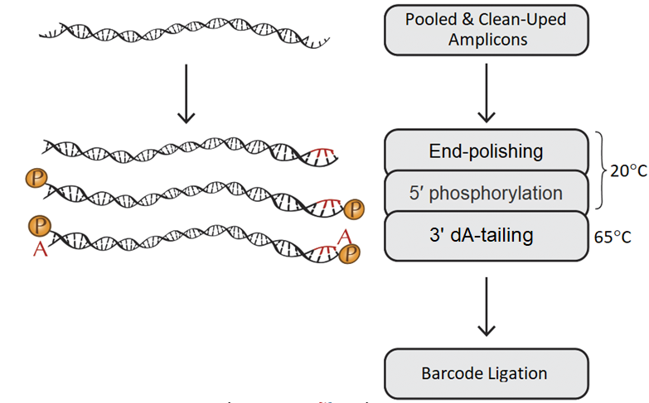
End Preparation (EP)
Three actions, end polishing, 5’ phosphorylation, 3’ da-tailing
Notes:
ready to use and optimized Enzyme Mix together with Reaction buffer to convert your amplicons to repaired fragments having 5′ phosphorylated, 3′ dA-tailed ends.
End-polishing – preparing blunted ends: it means remove 3’ overhangs and fill in 5’.
All ligations require a phosphate on the 5’ ends.
Add a single A (deoxyadenosine) to the 3’ ends – this tail will needed for barcode ligation.
Though you need few enzymes the end-prep reaction can be conduct in one tube. Because enzymes work at different temperature (while one active another one inactive).

Slide 14
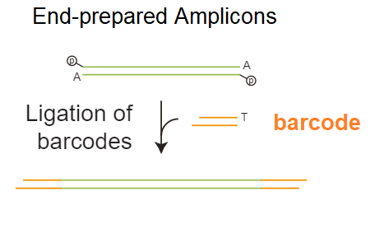
Barcode ligation
You will need:
NEBNext Ultra II Ligation Module Kit (NEB)
Native barcoding kit
End prepared amplicons
Chosen ONT native barcode kit
Notes:
Ligation Master Mix (module).
Use one native barcode from the EXP-NBD104 (1-12), EXP-NBD114 (13-24) or EXP-NBD196 per sample. Use 12 or more barcodes per library or there will be insufficient total material to achieve good yields.

Slide 15
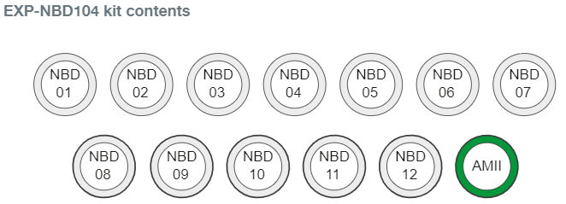
Barcode ligation
Native barcoding vs rapid barcoding, different mechanisms-different preps
Each barcode is a unique DNA sequence ligated to both ends of amplicons
ONT native barcode kits available:
EXP-NBD104 (1-12)
EXP-NBD1114 (13-24)
EXP-NBD196 (1-96)

Slide 16



